Slide 1
Stock Predication
(RNN and LSTM ) Prepared by Atul Bachhav & Kevin Arawattigi

Slide 2
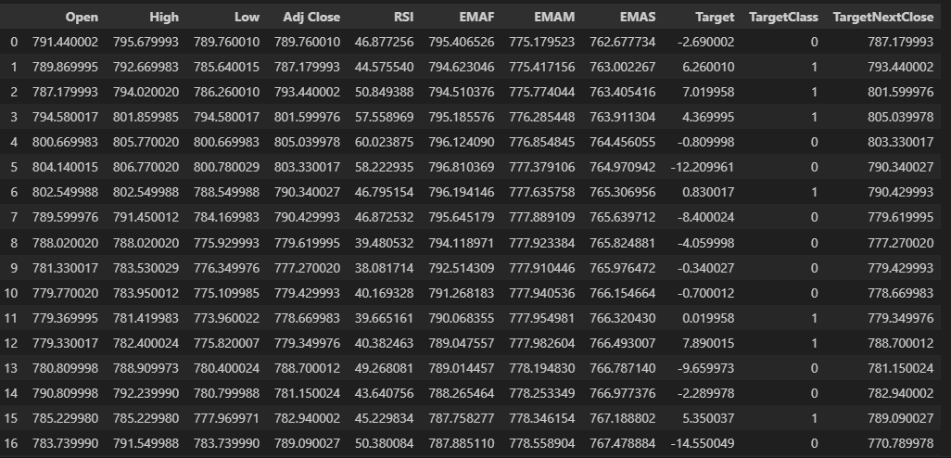
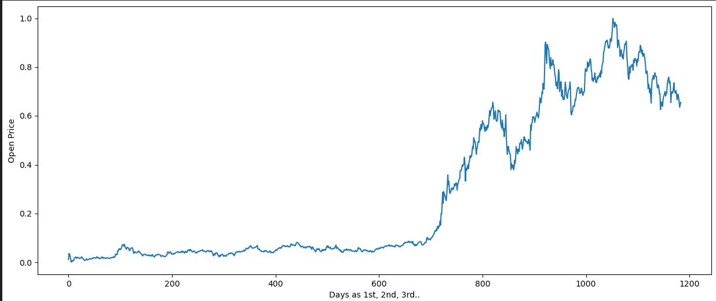
Data Preparation and Analysis
Use yahoo API to get historical stock data of various ticker.
Number of rows:
Feature List :

Slide 3
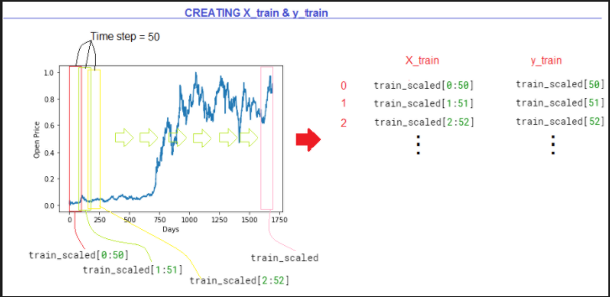
Data Splitting and Reshap

Slide 4
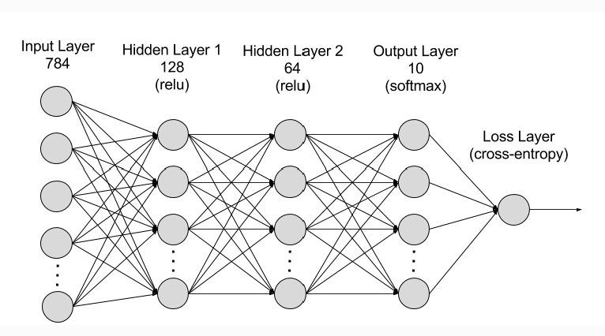
AI Model (RNN)
Number of hidden layer used = 4
Input layer feature count = 50
Activation Function used = Tanh
Output layer = 1

Slide 5
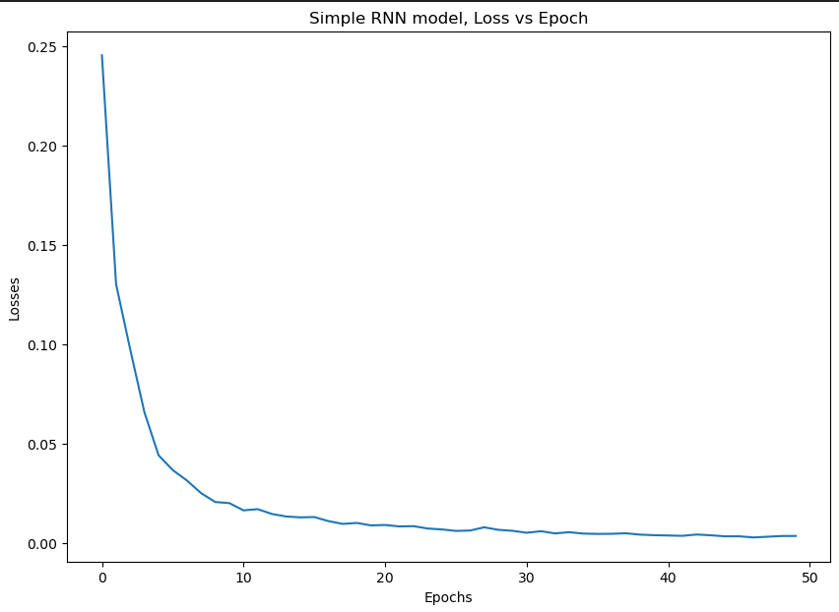
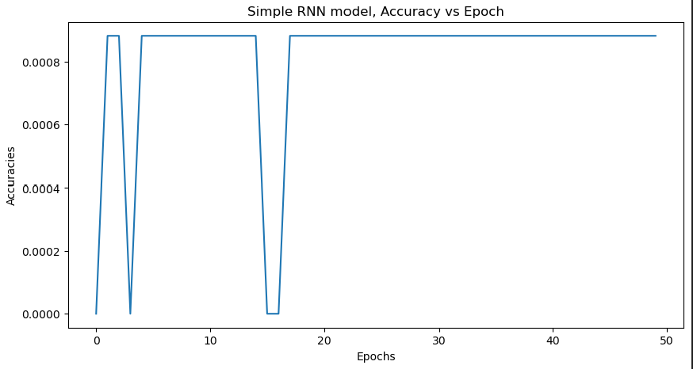
Model Evaluation

Slide 6
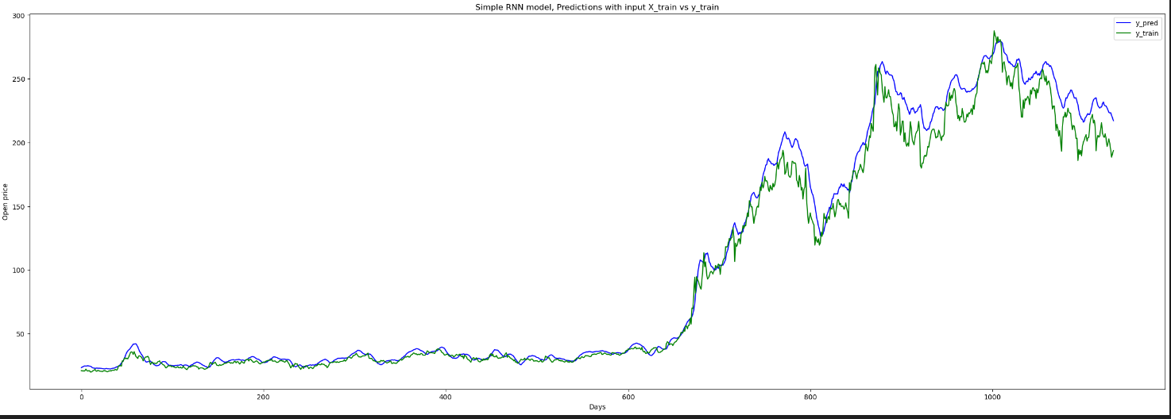
RNN Train vs Predication Data

Slide 7
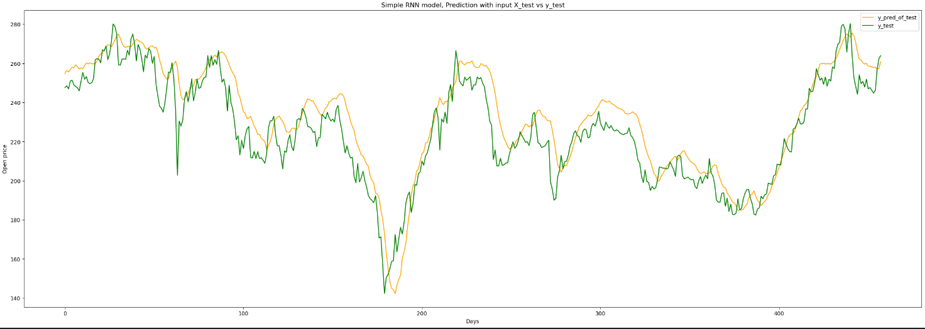
LSTM Train vs Test

Slide 8
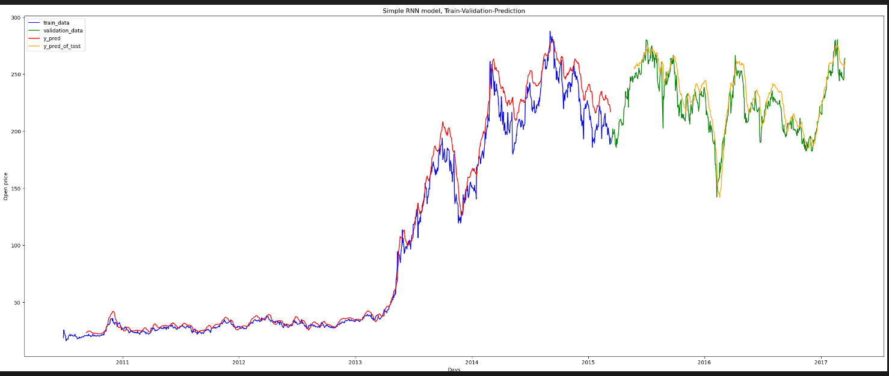

Slide 9
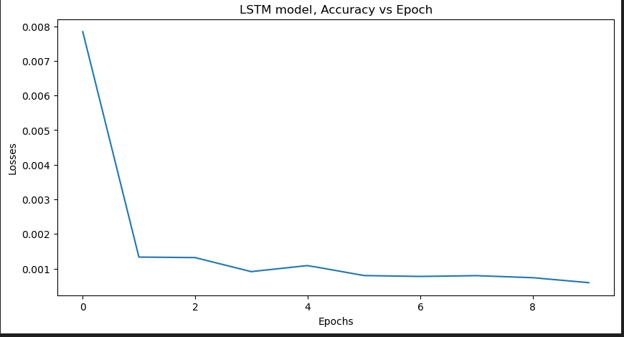
LSTM Model Accuracy vs Epoch

Slide 10
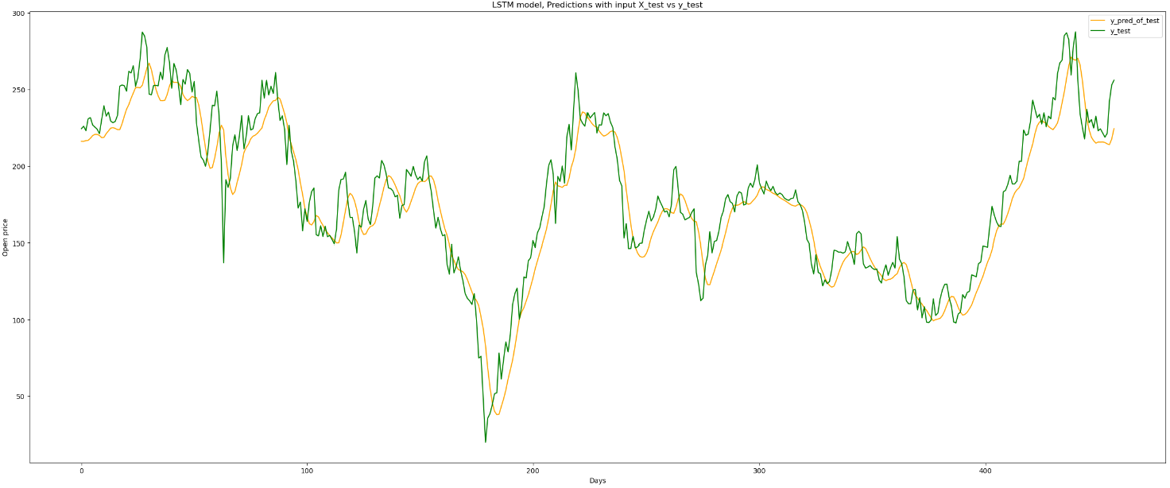
LSTM Model Predication

Slide 11
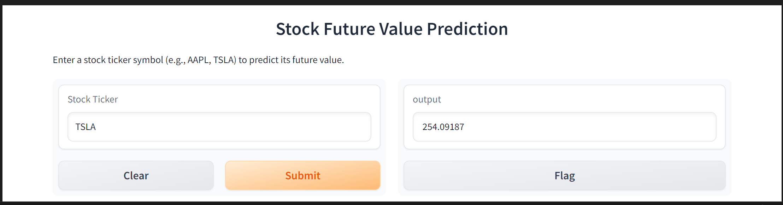
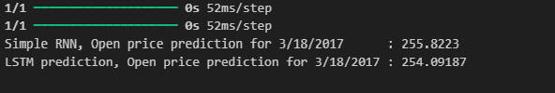
Future Price Predication

